Slide 1
18CSE390T
Computer Vision
S1 - SLO-1 -Active contours

Slide 2
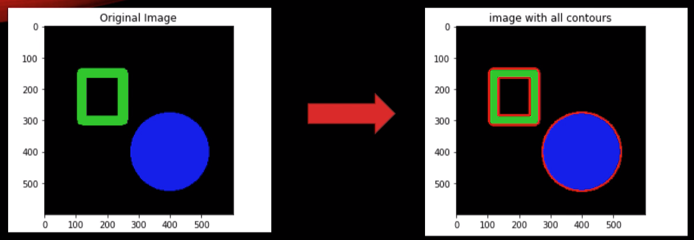
Image Contour

Slide 3
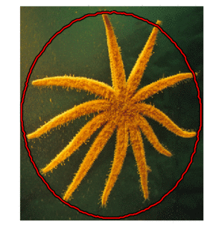
Image Contour

Slide 4
Active contours
Active contours and active surfaces are means of model- driven segmentation.
Their use enforces closed and smooth boundaries for each segmentation irrespective of the image content.
Data-driven (region) approaches: Objects in an image appear homogeneous
Model-driven (boundary) approaches: Ideal object boundary are predicted. The boundary is assumed to be smooth and closed

Slide 5
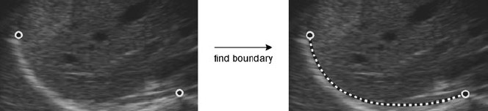
Active contours

Slide 6
APPROACHES
Techniques to locating boundary
Snakes is an energy-minimizing, two-dimensional spline curve that evolves (moves) towards image features such as strong edges.
Intelligent scissors allow the user to sketch in real time a curve that clings to object boundaries
Level set techniques evolve the curve as the zeroset of a characteristic function, which allows them to easily change topology and incorporate region-based statistics.

